Slide 1





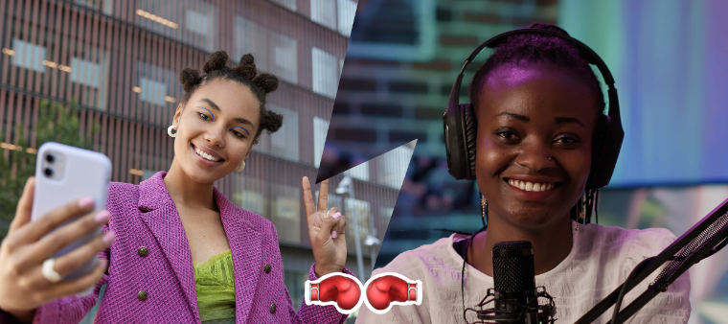





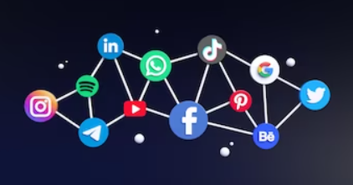
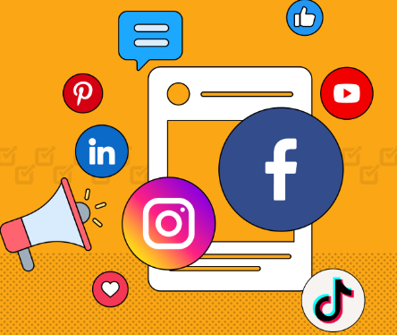



NarrativeFlicks
(App that generates visuals based on narration)
Lean Canvas Model
Key Partners Content Creators Influencers Social Media Platforms Educational Institutions App Store Google Play Store Partnership with Adobe, Canva, etc | Key Activities Continuous app improvement based on user feedback. Regular updates with fresh visual elements and themes. Execute marketing campaigns to attract new users and promote updates. | Value Propositions Interactive Storytelling Engagement Boost Offer a platform where users can create visually engaging narratives with images, graphics, and text Create visually appealing videos effortlessly, even without video editing skills Save time and resources compared to traditional video production methods Sophisticated AI-driven features that personalize the user experience |  | Customer Relationships Customer Support Community Engagement Enhanced Collaboration Exclusive Content for Subscribers Loyalty Program Promotions and limited-time offers User Onboarding – Tutorial guides Feedback Loop | Customer Segments YouTubers, bloggers, and social media influencers Content Creators - Individuals who want to visually express their stories, ideas, or concepts. Educators - Teachers and trainers seeking an interactive way to present information to their students. Business Professionals - Users seeking a visual storytelling tool for presentations and pitches.
 | Key Resources Development Team - Skilled developers for continuous improvement and updates. Marketing Team - To promote the app and engage with the user community. Content Libraries - A library of visual elements, templates, and themes for users to incorporate into their narratives. Server Infrastructure - Robust servers to handle video rendering and storage. |  |  | Channels App Stores Social Media Educational Partnerships Content Creation Communities
 |  |  |  | Channels App Stores Social Media Educational Partnerships Content Creation Communities
Cost Structure Development Cost - Ongoing expenses for maintaining and improving the app. Marketing Expenses - Budget for advertising, promotions, and partnerships. Content Licensing - Costs associated with creating and licensing visual elements. |  |  | Revenue Streams Freemium Model - Offer a free version with basic features and a premium subscription for advanced tools, templates, and collaboration features Monthly or annual subscription plans In-App Purchases for additional templates, effects or features Marketplace

